Slide 1

Procesamiento de Imágenes
Domingo Mery
Departmento de Ciencia de la Computación
Escuela de Ingeniería
Universidad Católica de Chile
Espacios de Color
[ Capítulo 2 ]

Slide 2
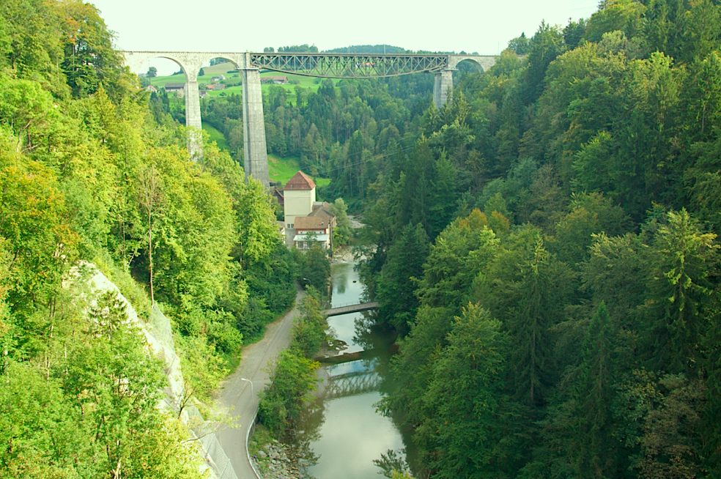

Slide 3
Notes:
Color is extremely subjective and personal. To try to attribute numbers to the brains reaction to visual stimuli is very difficult. The aim of color spaces is to aid the process of describing color, either between people or between machines or programs. http://biology.duke.edu/johnsenlab/pdfs/tech/colorconversion.pdf

Slide 4
El objetivo de los espacios de color es ayudar al proceso de la descripción del color, ya sea entre personas o entre computadores.
Notes:
Color is extremely subjective and personal. To try to attribute numbers to the brains reaction to visual stimuli is very difficult. The aim of color spaces is to aid the process of describing color, either between people or between machines or programs. http://biology.duke.edu/johnsenlab/pdfs/tech/colorconversion.pdf

Slide 5
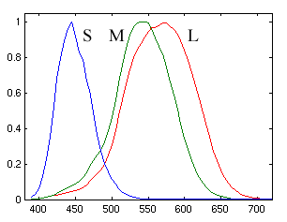
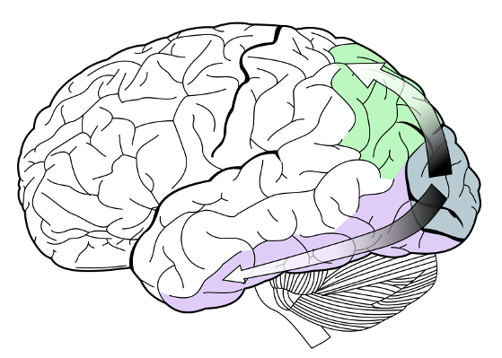
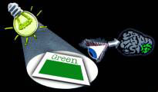
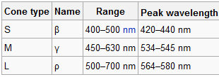
[ Percepción del Color ]
Notes:
Color is the brains reaction to a specific visual stimulus. Although we can precisely describe color by measuring its spectral power distribution (the intensity of the visible electro-magnetic radiation at many discrete wavelengths) this leads to a large degree of redundancy. The reason for this redundancy is that the eye’s retina samples color using only three broad bands, roughly corresponding to red, green and blue light. The signals from these color sensitive cells (cones), together with those from the rods (sensitive to intensity only), are combined in the brain to give several different “sensations” of the color. http://biology.duke.edu/johnsenlab/pdfs/tech/colorconversion.pdf

Slide 6
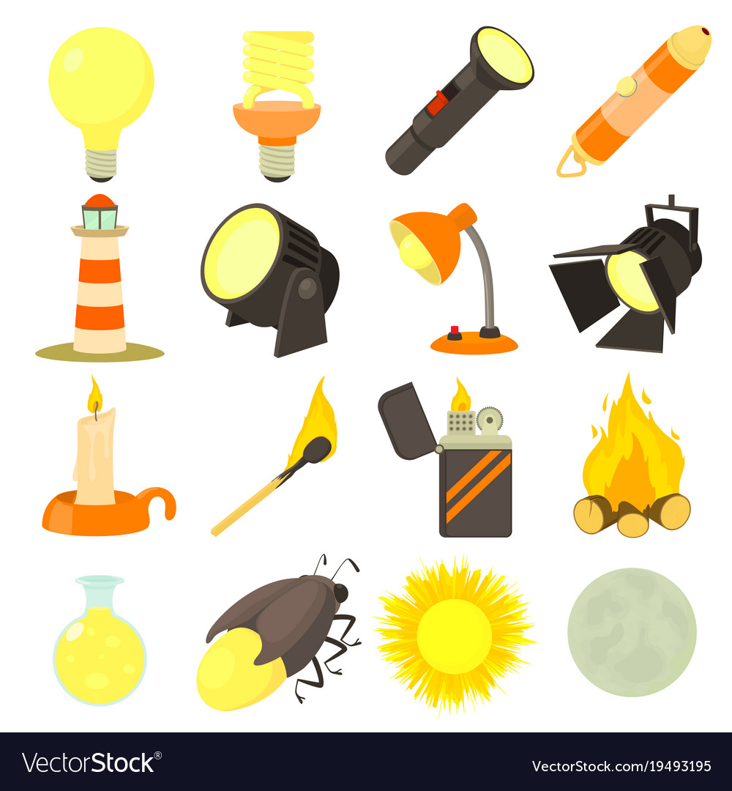
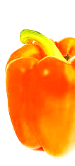
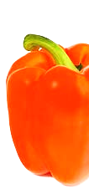
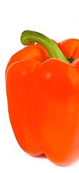
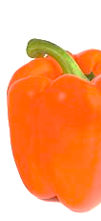
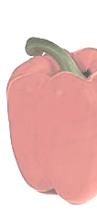
[ Percepción del Color ]
No olvidar que el color depende del espectro de la fuente
© VectorStock, ID = 19493195

Slide 7
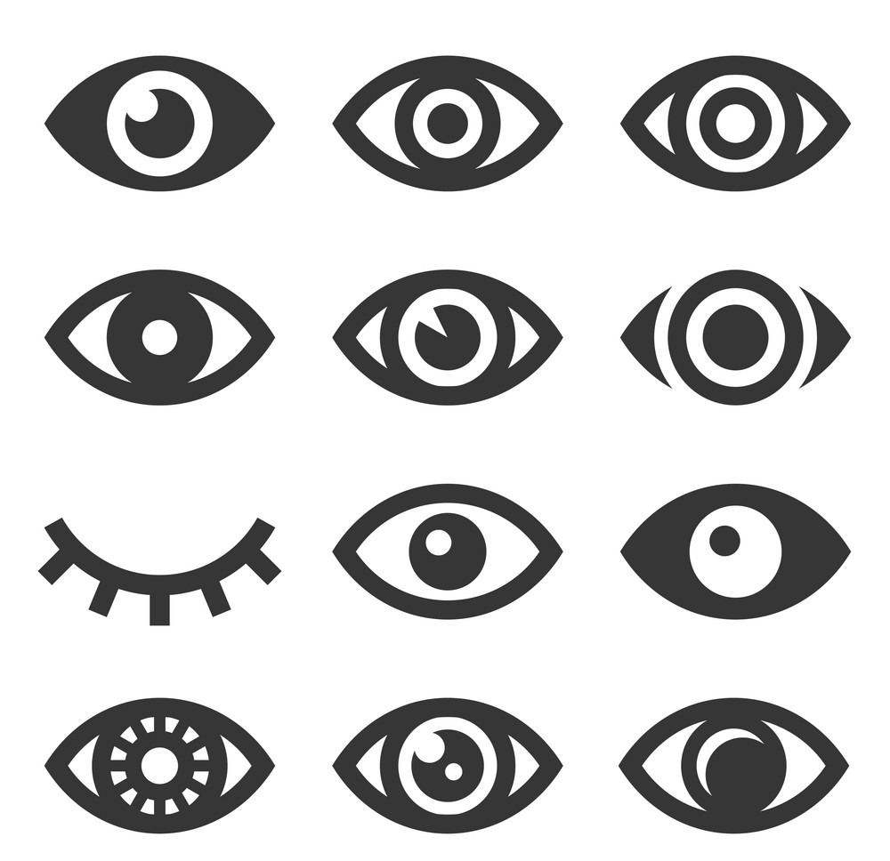
[ Percepción del Color ]
Y depende también de los ojos que miran
© VectorStock, ID = 17886903

Slide 8
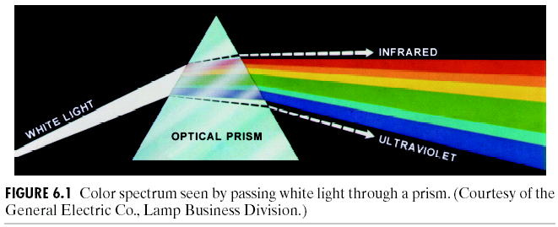
[ Prisma Óptico ]

Slide 9
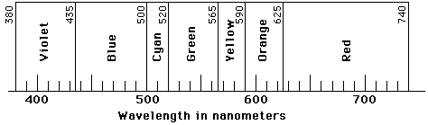
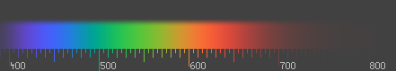
[ Definición del Color ]
El color es el resultado de la percepción de la luz en espectro visible, con longitudes de onda entre 400 nm y 700 nm, que inciden en la retina del ojo.
Longitud de onda [nm]

Slide 10
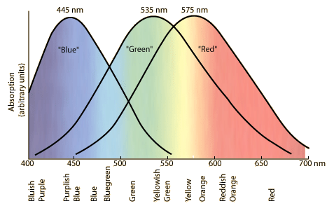
[ Respuesta del ojo humano ]
Notes:
The tri-chromatic theory describes the way three separate lights, red, green and blue, can match any visible colour – based on the eye’s use of three colour sensitive sensors. This is the basis on which photography and printing operate, using three different coloured dyes to reproduce colour in a scene. It is also the way that most computer colour spaces operate, using three parameters to define a colour.

Slide 11
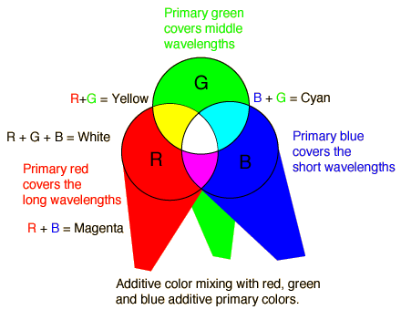
[ Modelo Aditivo ]

Slide 12

[ Modelo Substractivo ]
El color que muestra una superficie depende de las partes del espectro visible que no son absorbidas y por lo tanto permanecen visibles.
XXXXXX XXXXXXXXX
Luz Blanca
(todos los colores)

Slide 13
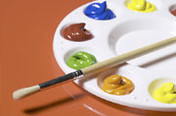
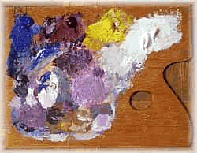
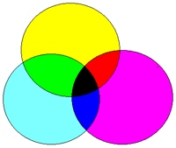
[ Modelo Substractivo ]
Los objetos restan longitudes de onda de la luz, dándole color

Slide 14
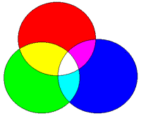
[ Mezcla de Colores ]
ADITIVO
Colores Primarios: RGB
SUBSTRACTIVO
Colores Primarios :YMC, YMCK, RYB

Slide 15
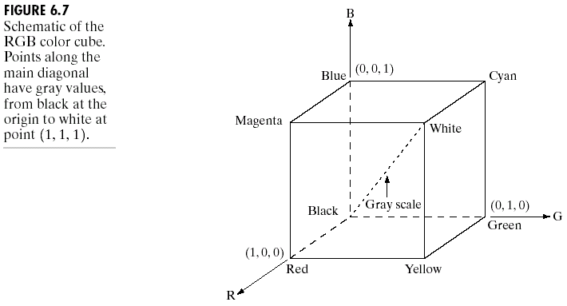
[ Espacio de Color RGB ]
R. Gonzalez, R. Woods, S. Eddins (2009): Digital Image Processing Using MATLAB, 2nd edition. Gatesmark Publishing.

Slide 16
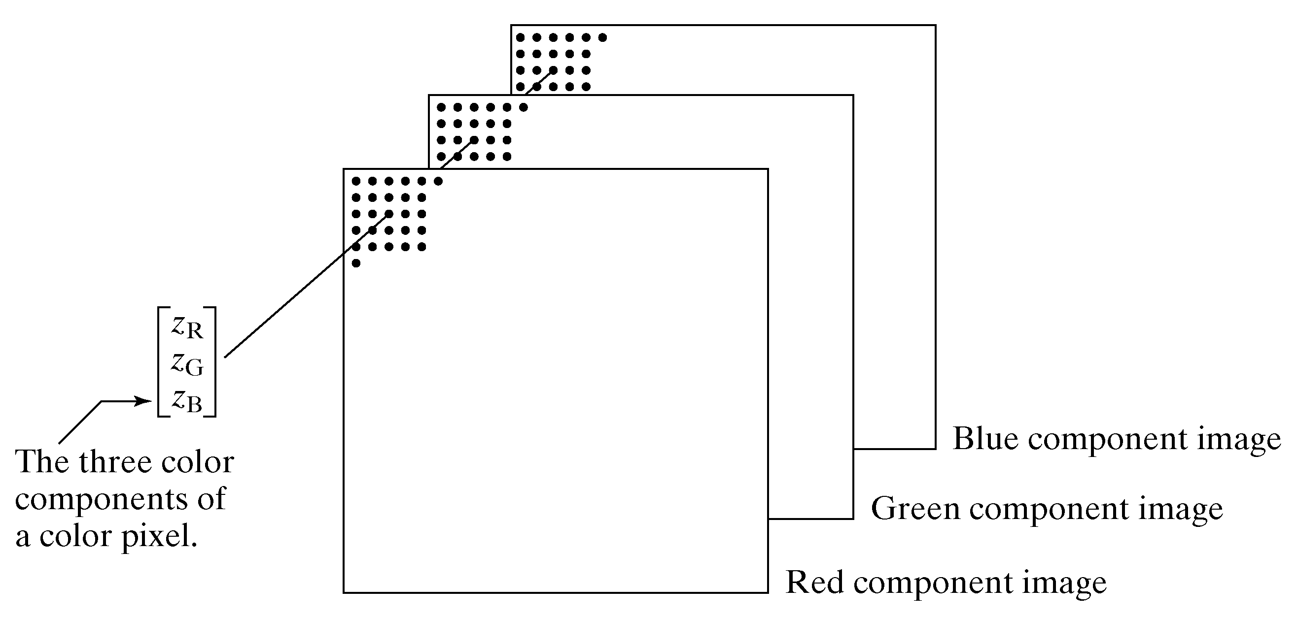
[ Espacio de Color RGB: Cómo se almacena una imagen a color 1/2 ]
Imagen digital a color
La imagen a color de N x M pixeles es almacenada como tres matrices de NxM pixeles, una para cada color (R,G,B). Así, el color del pixel (i,j) queda definido por el color dado por R(i,j), G(i,j) y B(i,j).
R. Gonzalez, R. Woods, S. Eddins (2009): Digital Image Processing Using MATLAB, 2nd edition. Gatesmark Publishing.

Slide 17
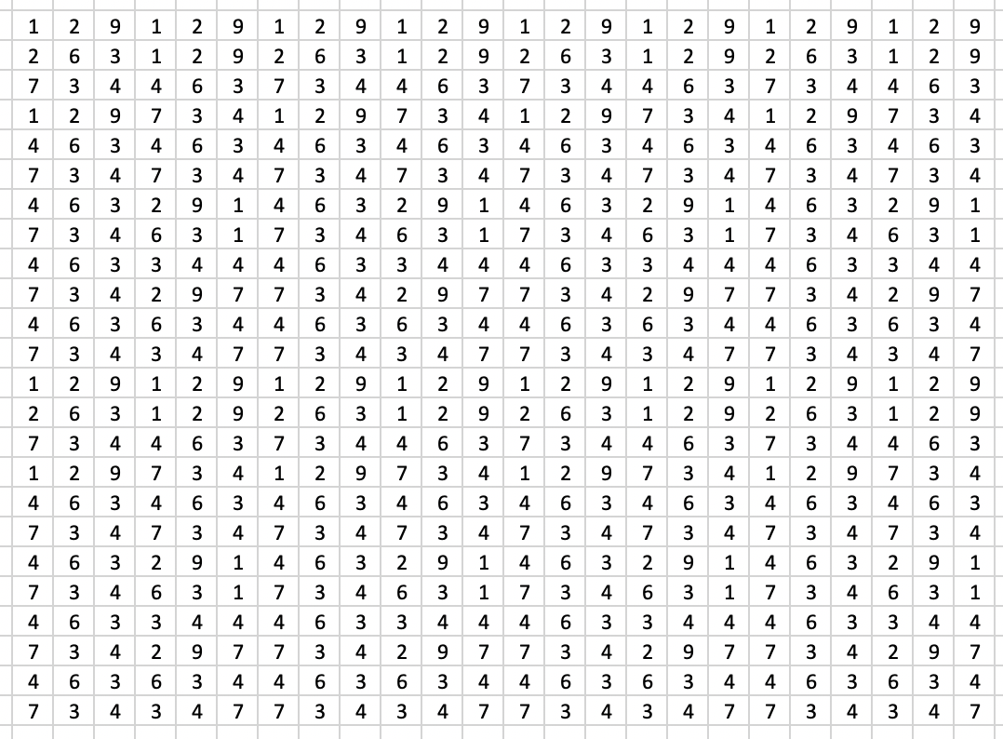
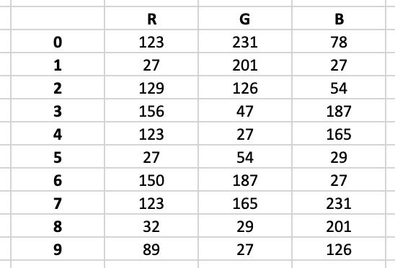
[ Espacio de Color RGB: Cómo se almacena una imagen a color 2/2 ]
Imagen (X)
Paleta
La imagen a color de N x M pixeles es almacenada como una matriz X de NxM pixeles que almacena índices de 0 a n-1, y una paleta de colores almacenada como una matriz de n x 3 elementos. Así, el color del pixel (i,j) de la imagen está definido en la fila k de la paleta, donde k = X(i,j).

Slide 18
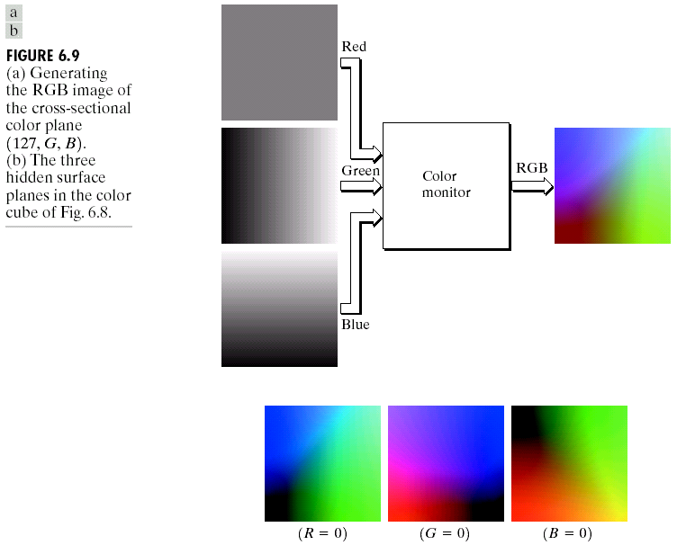
[ Espacio de Color RGB ]
R. Gonzalez, R. Woods, S. Eddins (2009): Digital Image Processing Using MATLAB, 2nd edition. Gatesmark Publishing.

Slide 19
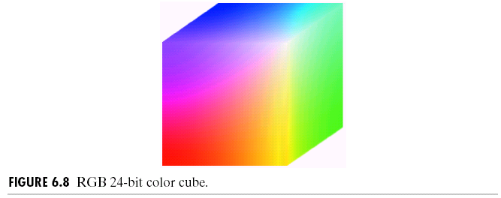
[ Espacio de Color RGB ]

Slide 20

[ Espacio de Color HSV ]

Slide 21
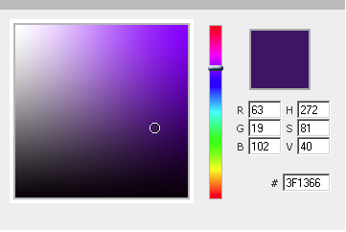
[ Espacio de Color HSV ]
Color Picker Tool:
http://www.dynamicdrive.com/dynamicindex11/yuicolorpicker/index.htm
H
V
S

Slide 22
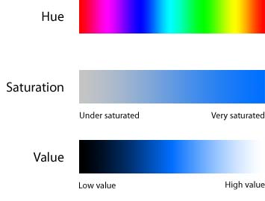
[ Espacio de Color HSV ]

Slide 23
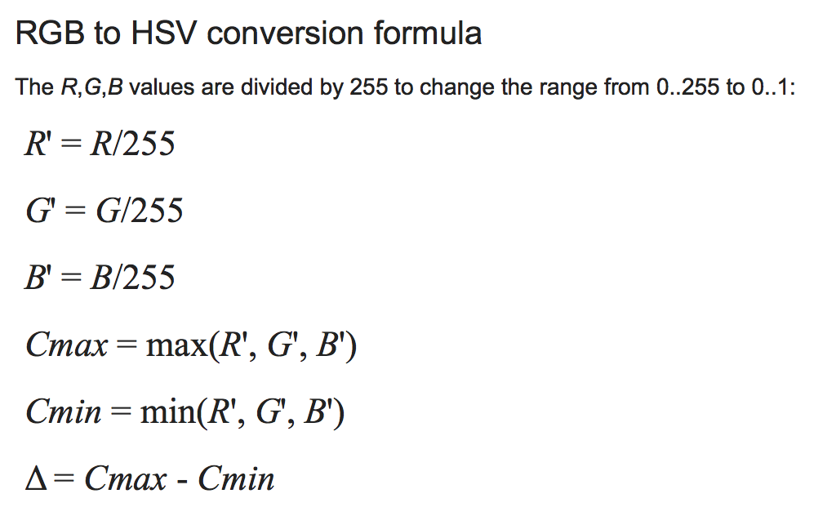
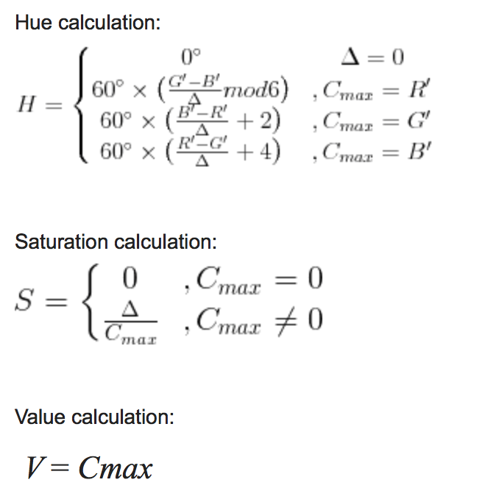
[ Espacio de Color HSV ]
Conversión RGB a HSV

Slide 24
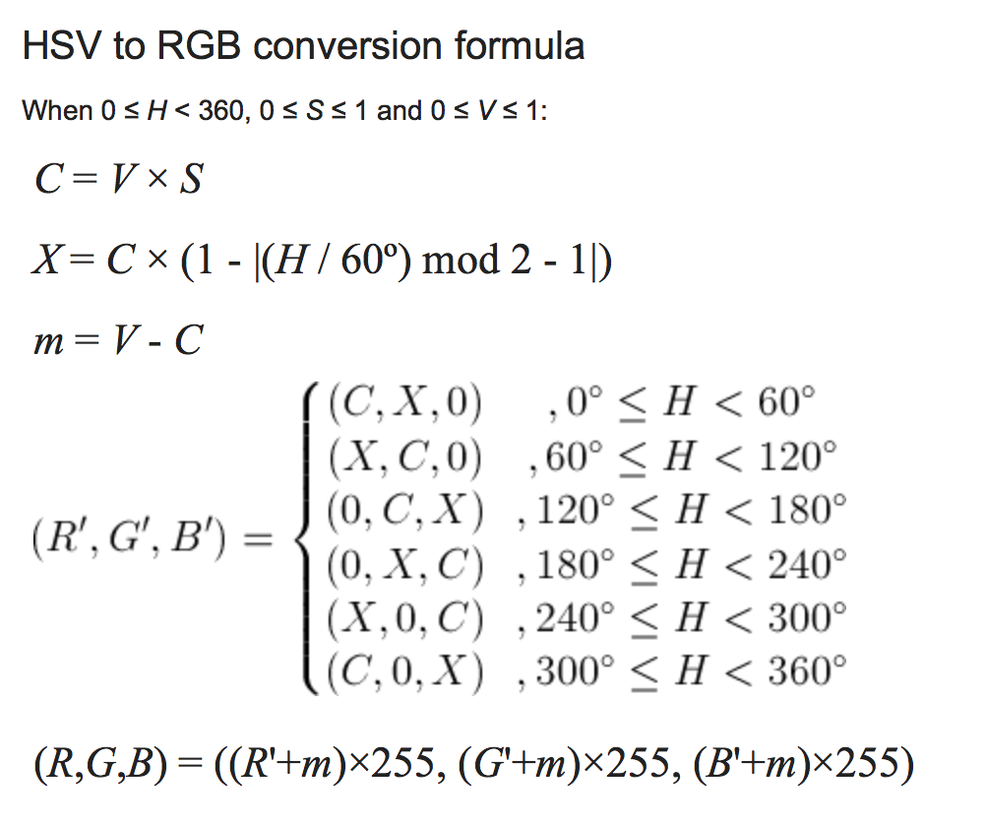
[ Espacio de Color HSV ]
Conversión HSV a RGB

Slide 25
[ Lightroom Demo ]

Slide 26
[ Cómo mejororar una imagen a color ]
Tomar la imagen a color
Convertir RGB a HSV
Ecualizar sólo el canal V
Convertir el nuevo HSV a RGB
Fin

Slide 27
[ Matlab Demo ]

Slide 28
Otros Espacios de Color

Slide 29
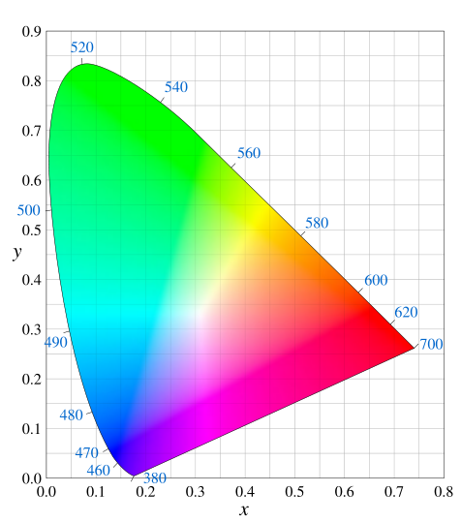
[ Diagrama CIE xy ]

Slide 30
[ Diagrama CIE xy ]
Posibles colores usando mezcla aditiva
Source 1
Source 2

Slide 31
[ Diagrama CIE xy ]
Posibles colores usando mezcla aditiva
Source 1
Source 2
Source 3

Slide 32
[ Diagrama CIE xy ]
Hue

Slide 33
[ Diagrama CIE xy ]
Saturación

Slide 34
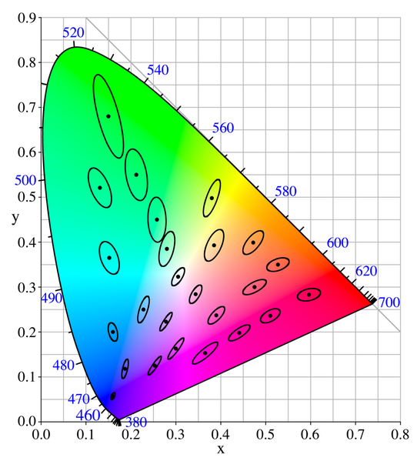
[ Colores Similares: Elipses de MacAdam ]

Slide 35
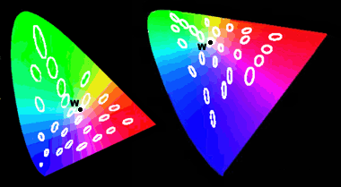
[ Diagrama CIE xy vs. CIE u’v’: Elipses de MacAdam ]

Slide 36

[ Diagram CIE RGB ]

Slide 37
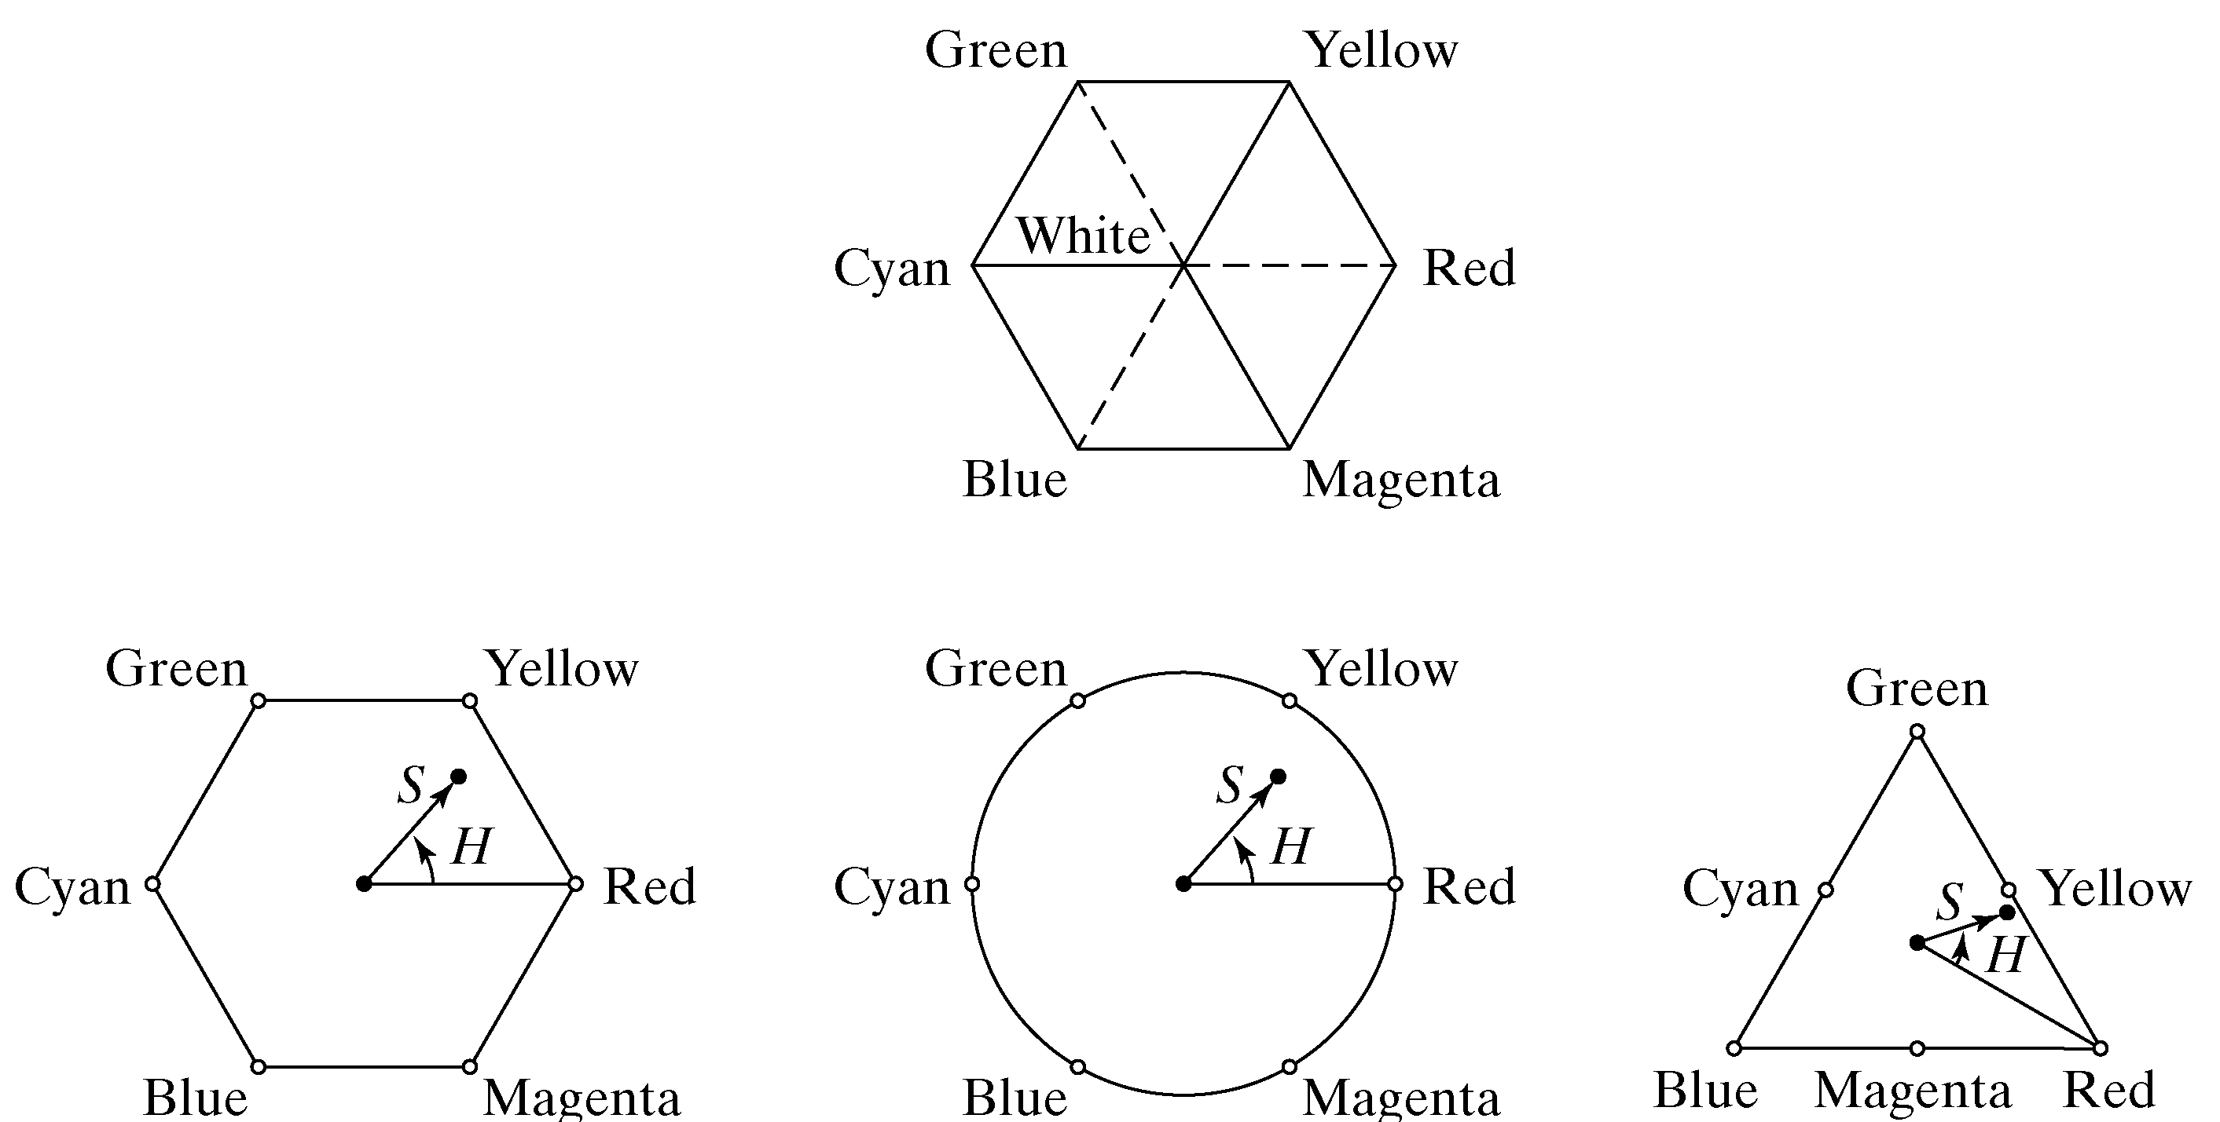
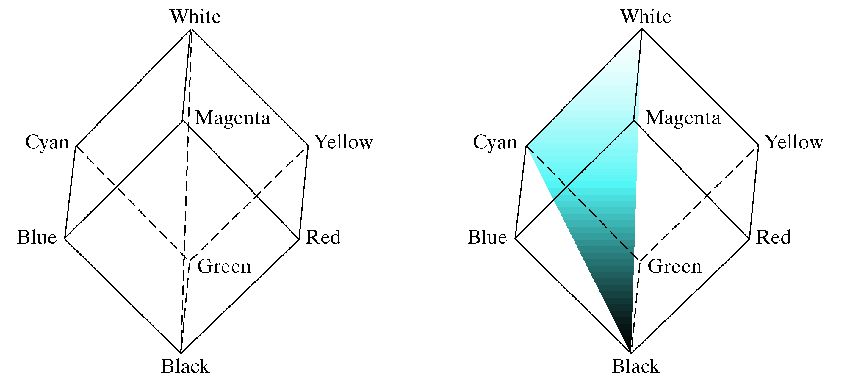
[ Color Space HSI ]

Slide 38
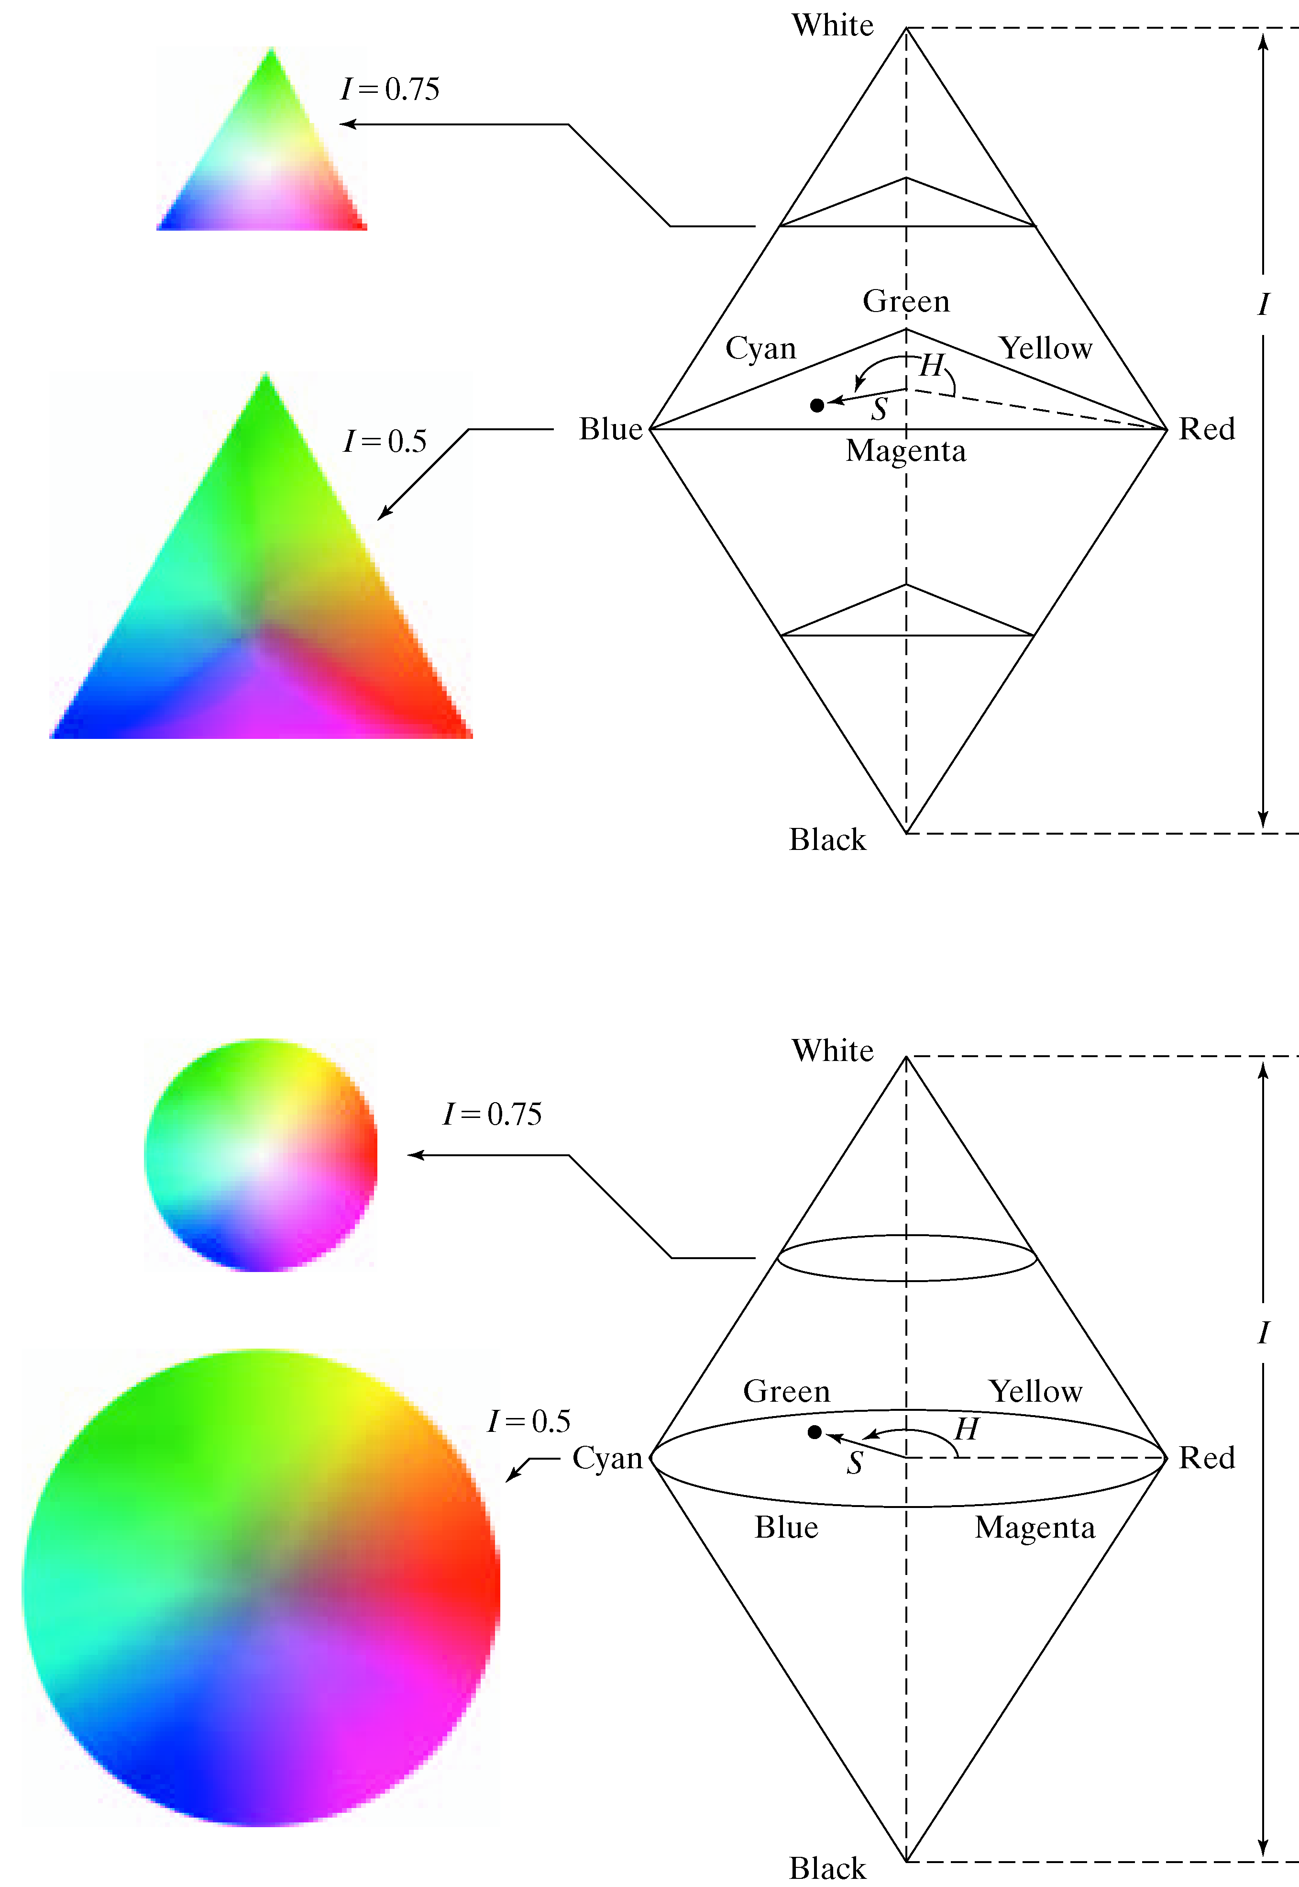
[ Color Space HSI ]

Slide 39
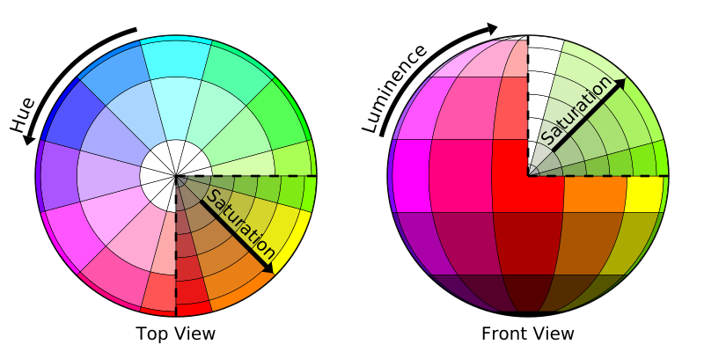
[ Color Space HSL ]

Slide 40
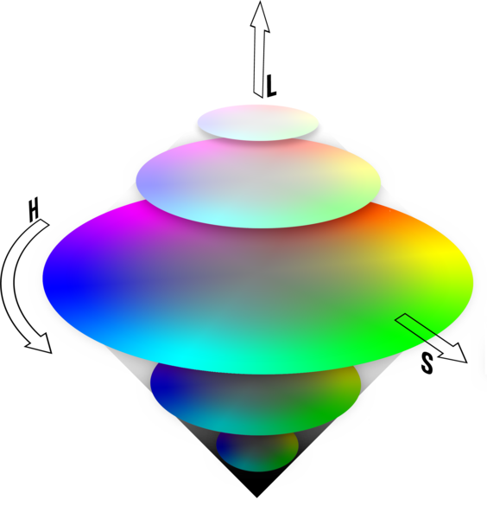
[ Color Space HSL ]

Slide 41
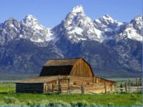
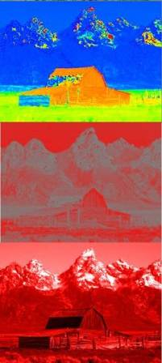
[ Color Space HSL ]
H
S
L

Slide 42
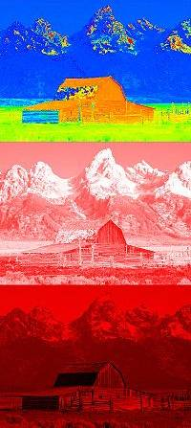
[ Color Space HSV ]
H
S
V

Slide 43
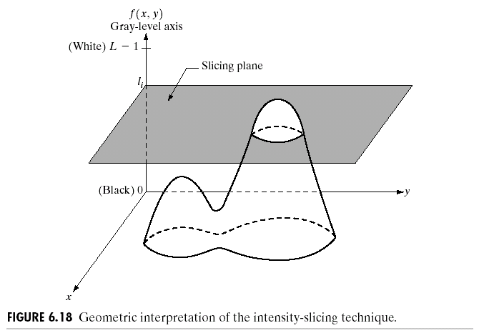
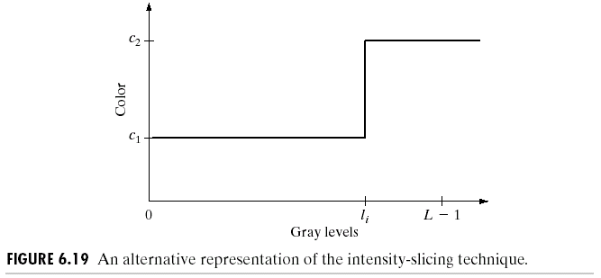
[ Pseudocolor ]
R. Gonzalez, R. Woods, S. Eddins (2009): Digital Image Processing Using MATLAB, 2nd edition. Gatesmark Publishing.

Slide 44
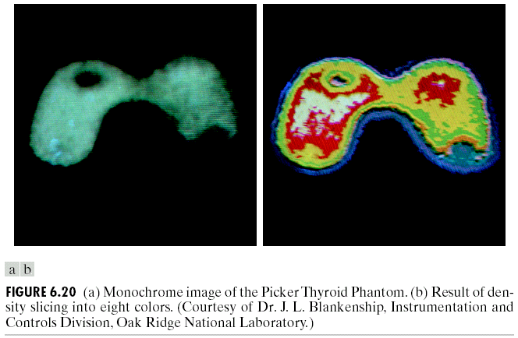
[ Pseudocolor ]
R. Gonzalez, R. Woods, S. Eddins (2009): Digital Image Processing Using MATLAB, 2nd edition. Gatesmark Publishing.

Slide 45
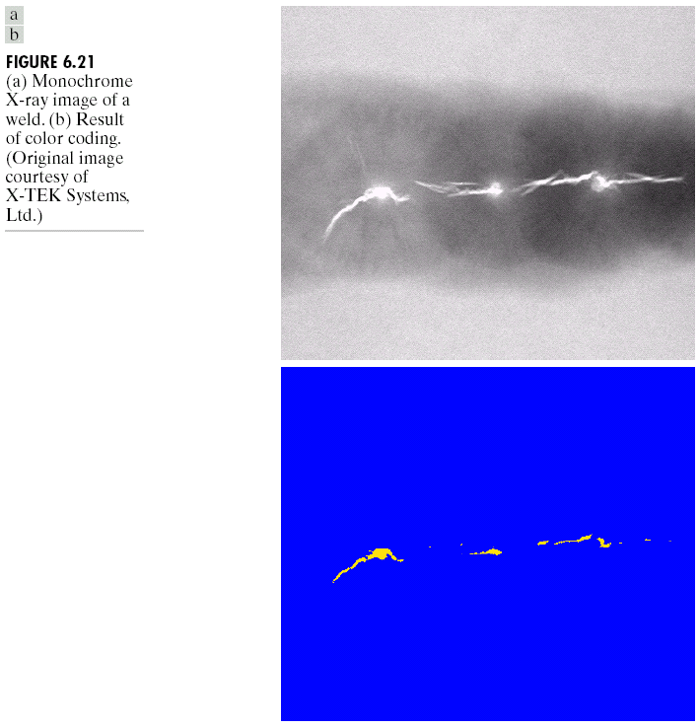
[ Pseudocolor ]
R. Gonzalez, R. Woods, S. Eddins (2009): Digital Image Processing Using MATLAB, 2nd edition. Gatesmark Publishing.

Slide 46
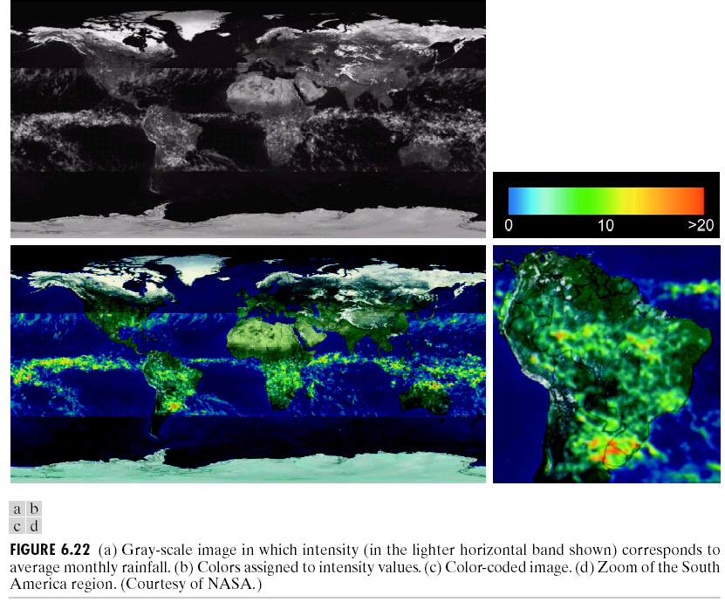
[ Pseudocolor ]
R. Gonzalez, R. Woods, S. Eddins (2009): Digital Image Processing Using MATLAB, 2nd edition. Gatesmark Publishing.

Slide 47
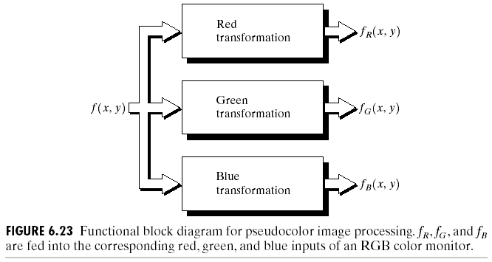
[ Pseudocolor ]
R. Gonzalez, R. Woods, S. Eddins (2009): Digital Image Processing Using MATLAB, 2nd edition. Gatesmark Publishing.

Slide 48
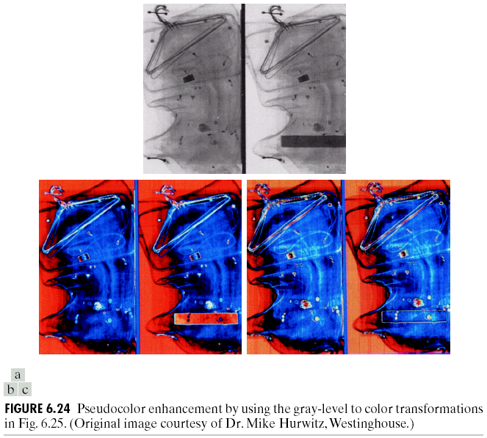
[ Pseudocolor ]
R. Gonzalez, R. Woods, S. Eddins (2009): Digital Image Processing Using MATLAB, 2nd edition. Gatesmark Publishing.

Slide 49

[ Pseudocolor ]
R. Gonzalez, R. Woods, S. Eddins (2009): Digital Image Processing Using MATLAB, 2nd edition. Gatesmark Publishing.

Slide 50

[ Pseudocolor ]
R. Gonzalez, R. Woods, S. Eddins (2009): Digital Image Processing Using MATLAB, 2nd edition. Gatesmark Publishing.

Slide 51



[ Pseudocolor ]
R. Gonzalez, R. Woods, S. Eddins (2009): Digital Image Processing Using MATLAB, 2nd edition. Gatesmark Publishing.

Slide 52

[ Pseudocolor ]

Slide 53

[ Temperature of Color ]

Slide 54


[ Temperature of Color ]

